Slide 1
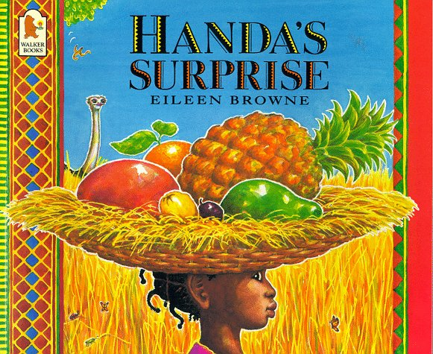

Slide 2
• Is the basket very heavy?
• Is it easy to carry a basket on your head?
• How does the basket balance?
• What is the green fruit?
• Where might the girl be going with the fruit?
• Is she looking at something behind her?
• What is the ostrich going to do?
• Where has the banana skin come from?

Slide 3
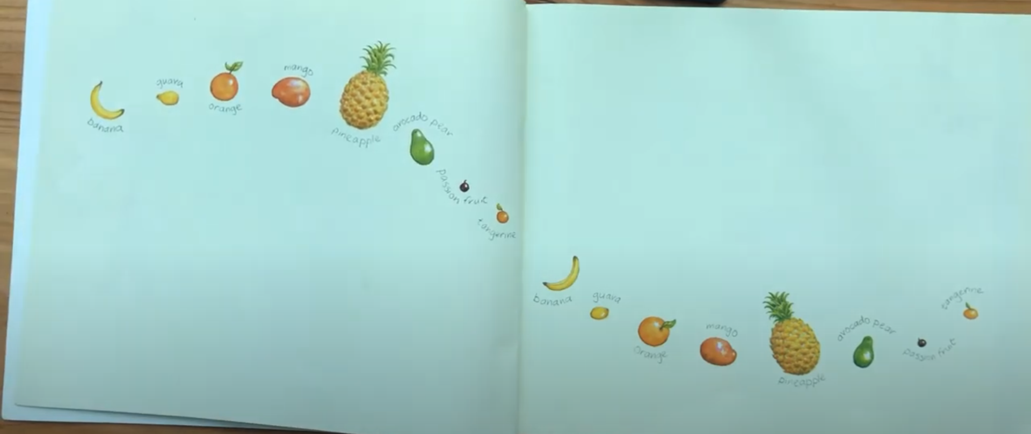

Slide 4
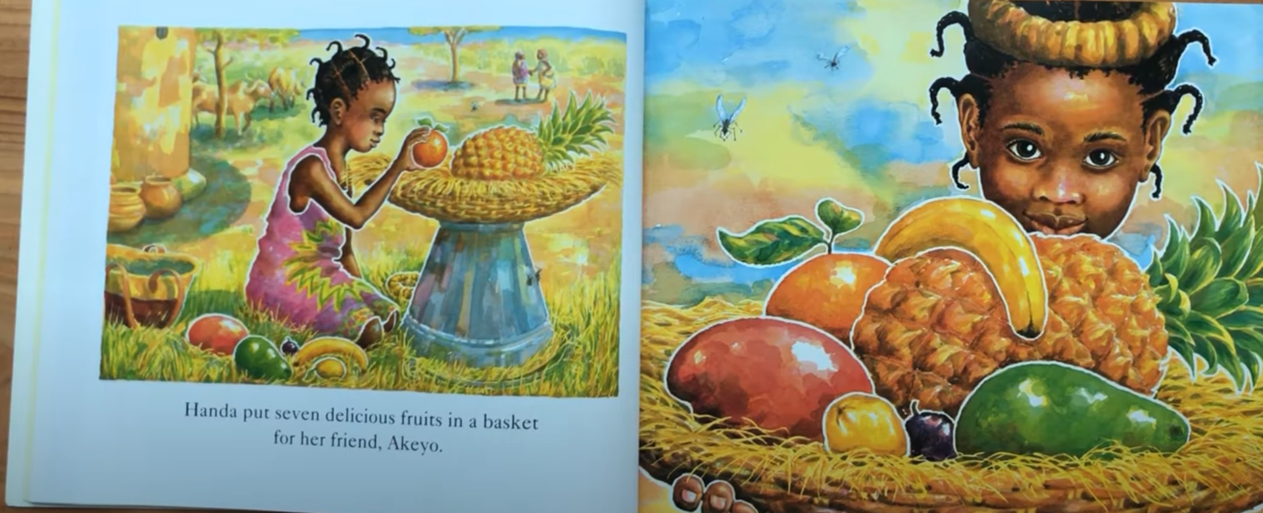
Handa put seven delicious fruits in a basket for her friend, Akeyo.

Slide 5
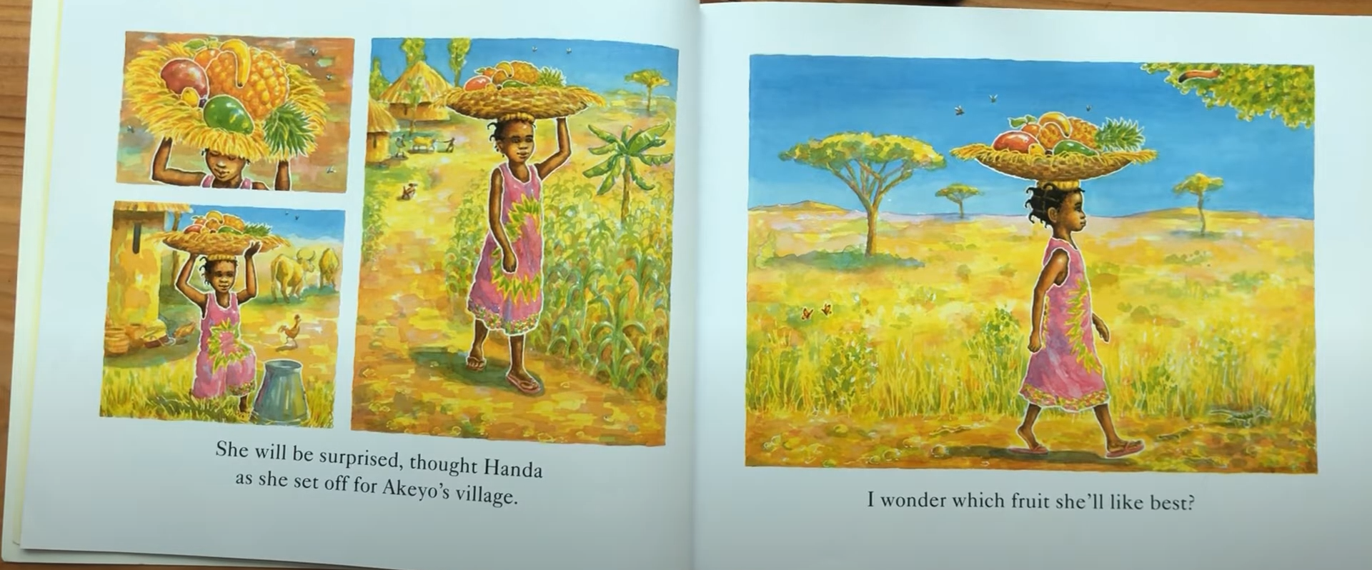
She will be surprised, thought Handa as she set off for Akeyo’s village.
I wonder which fruit she’ll like best?

Slide 6
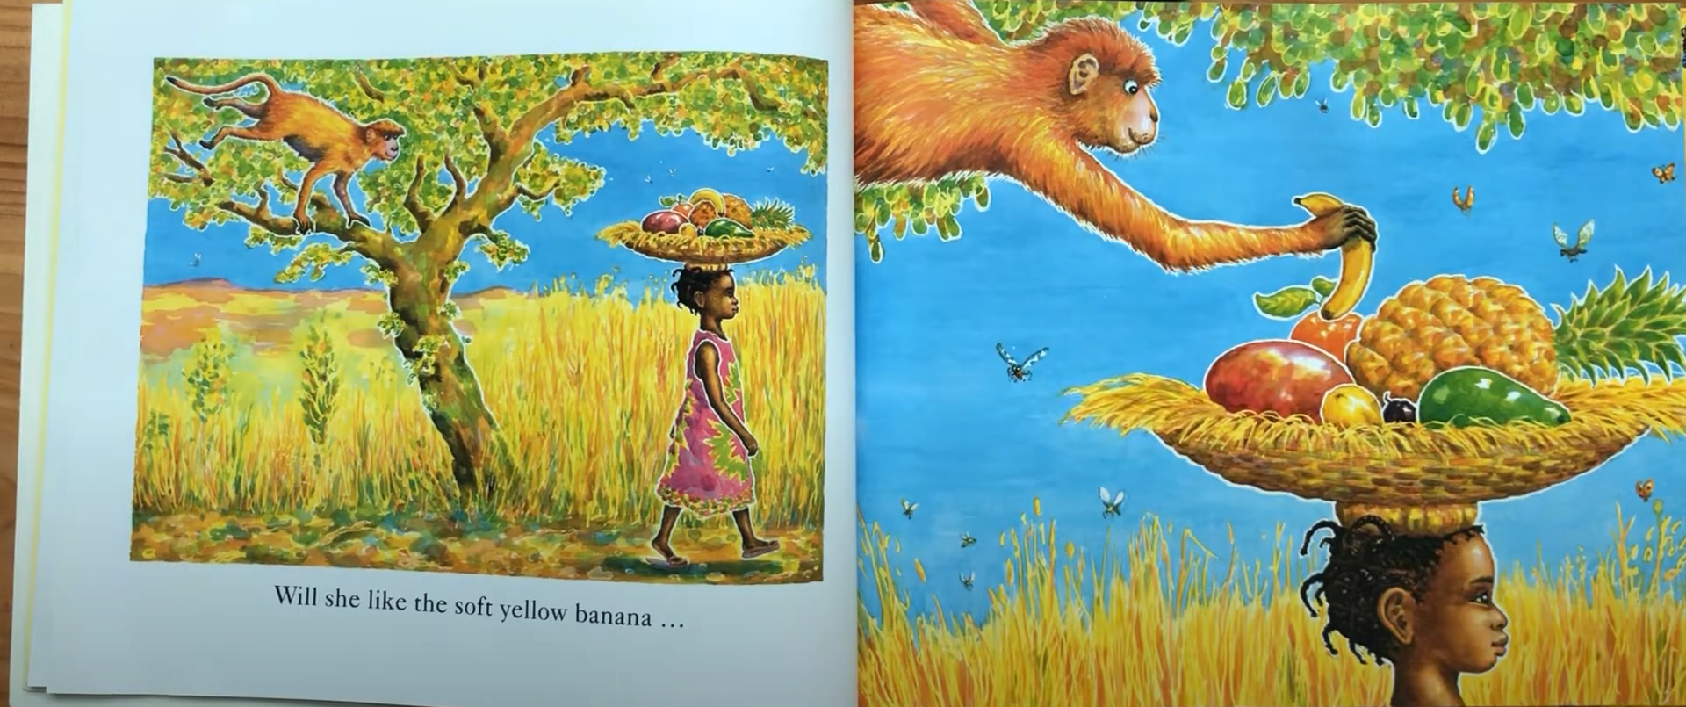
Will she like the soft yellow banana...

Slide 7
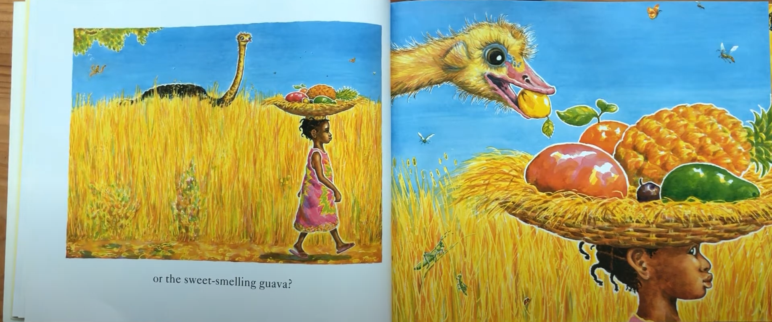
Or the sweet-smelling guava?

Slide 8
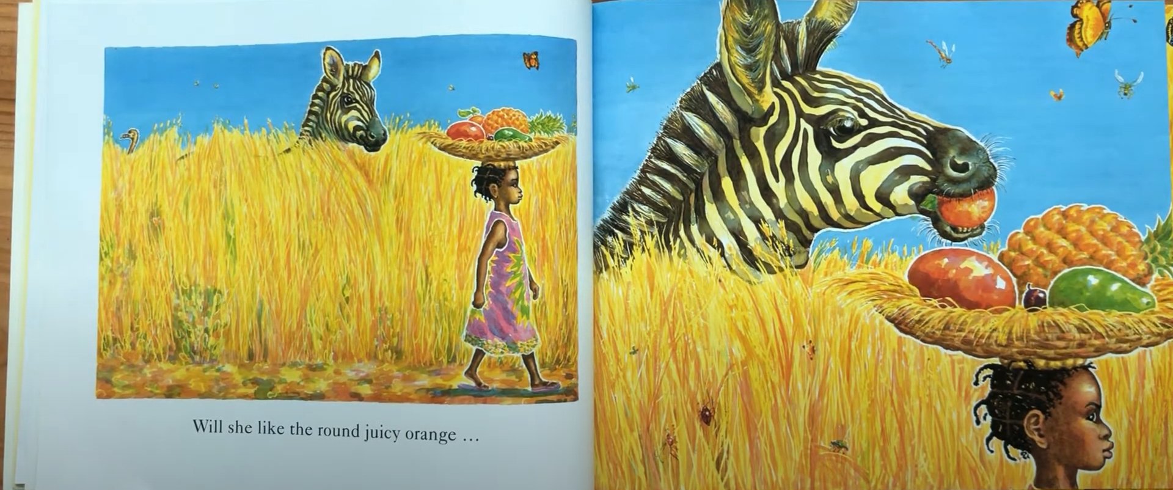
Will she like the round juicy orange...

Slide 9
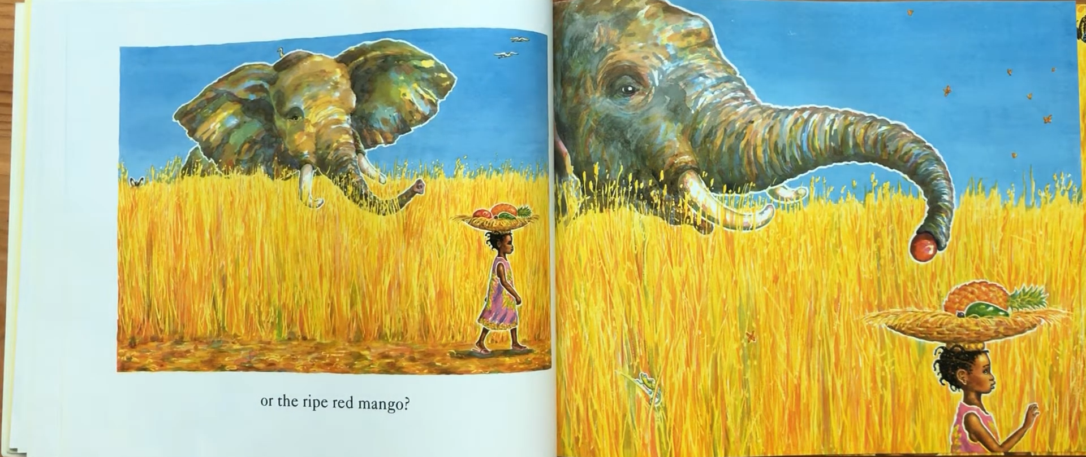
Or the ripe red mango?

Slide 10
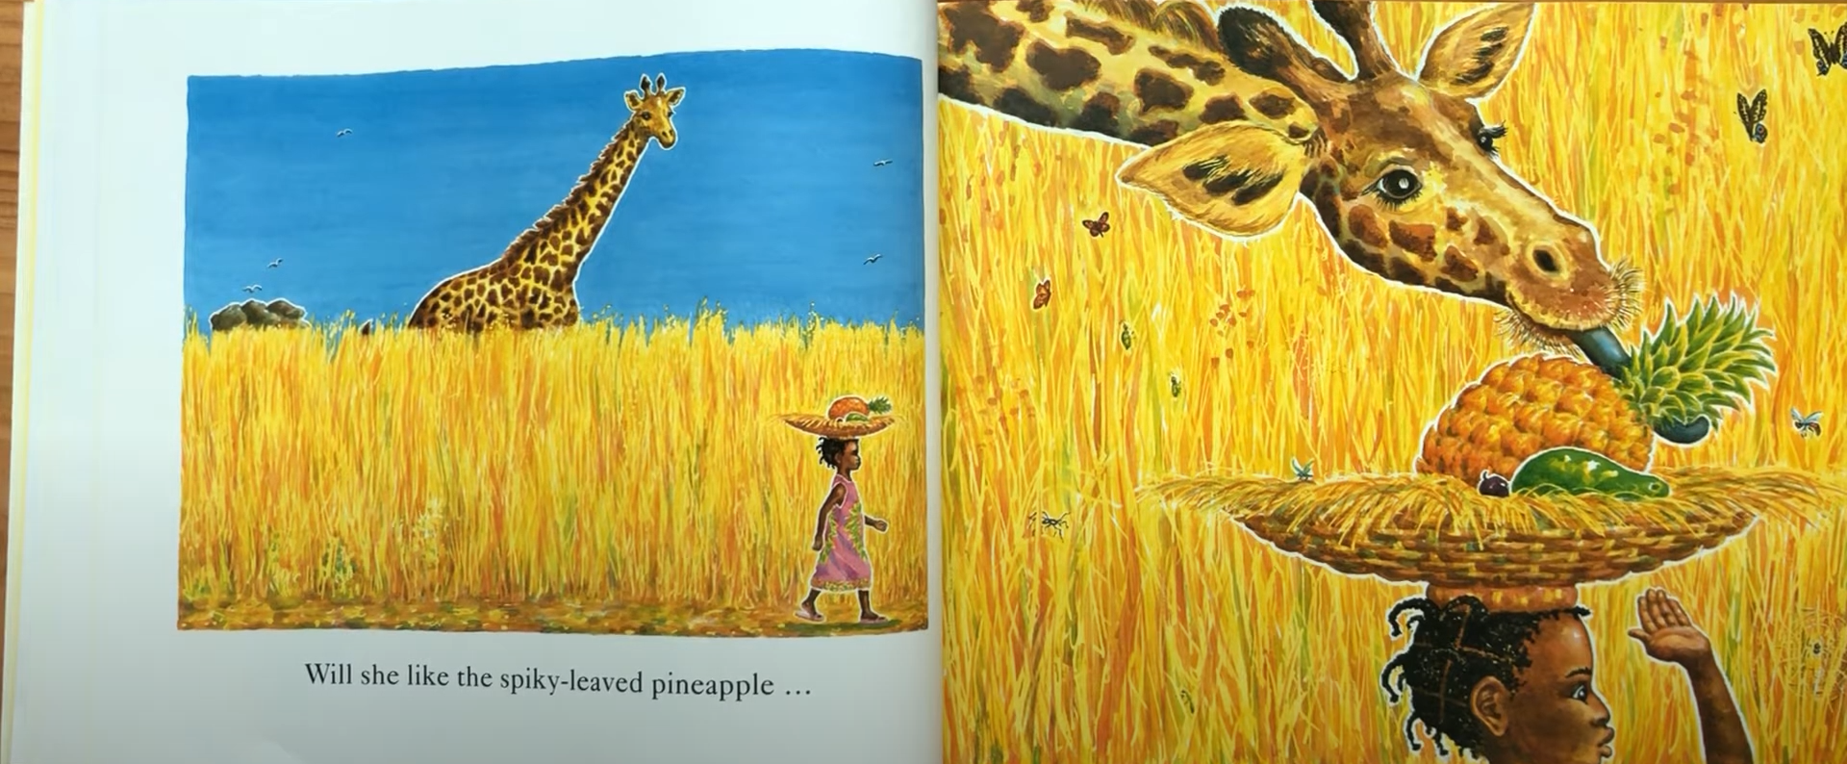
Will she like the spiky-leaved pineapple...

Slide 11
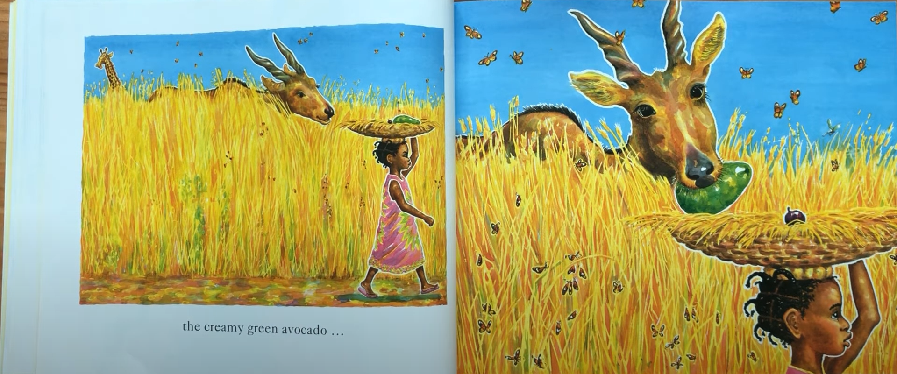
the creamy green avocado...

Slide 12
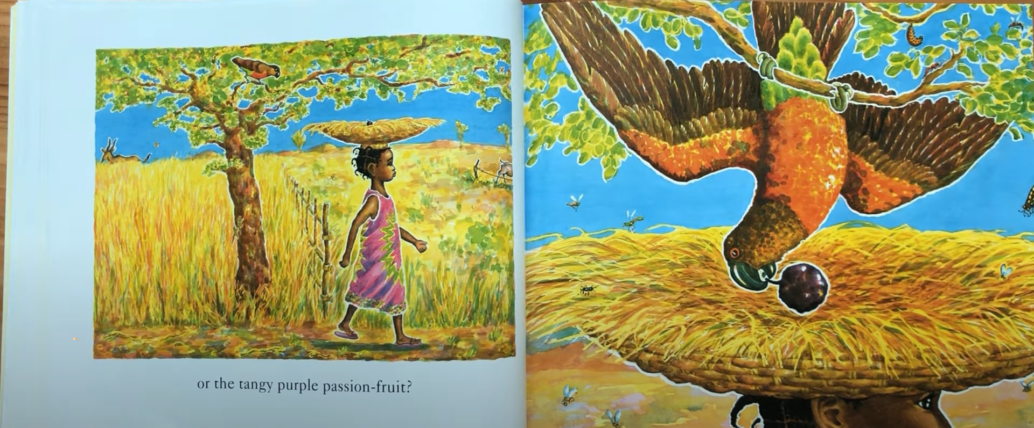
Or the tangy purple passion-fruit?

Slide 13
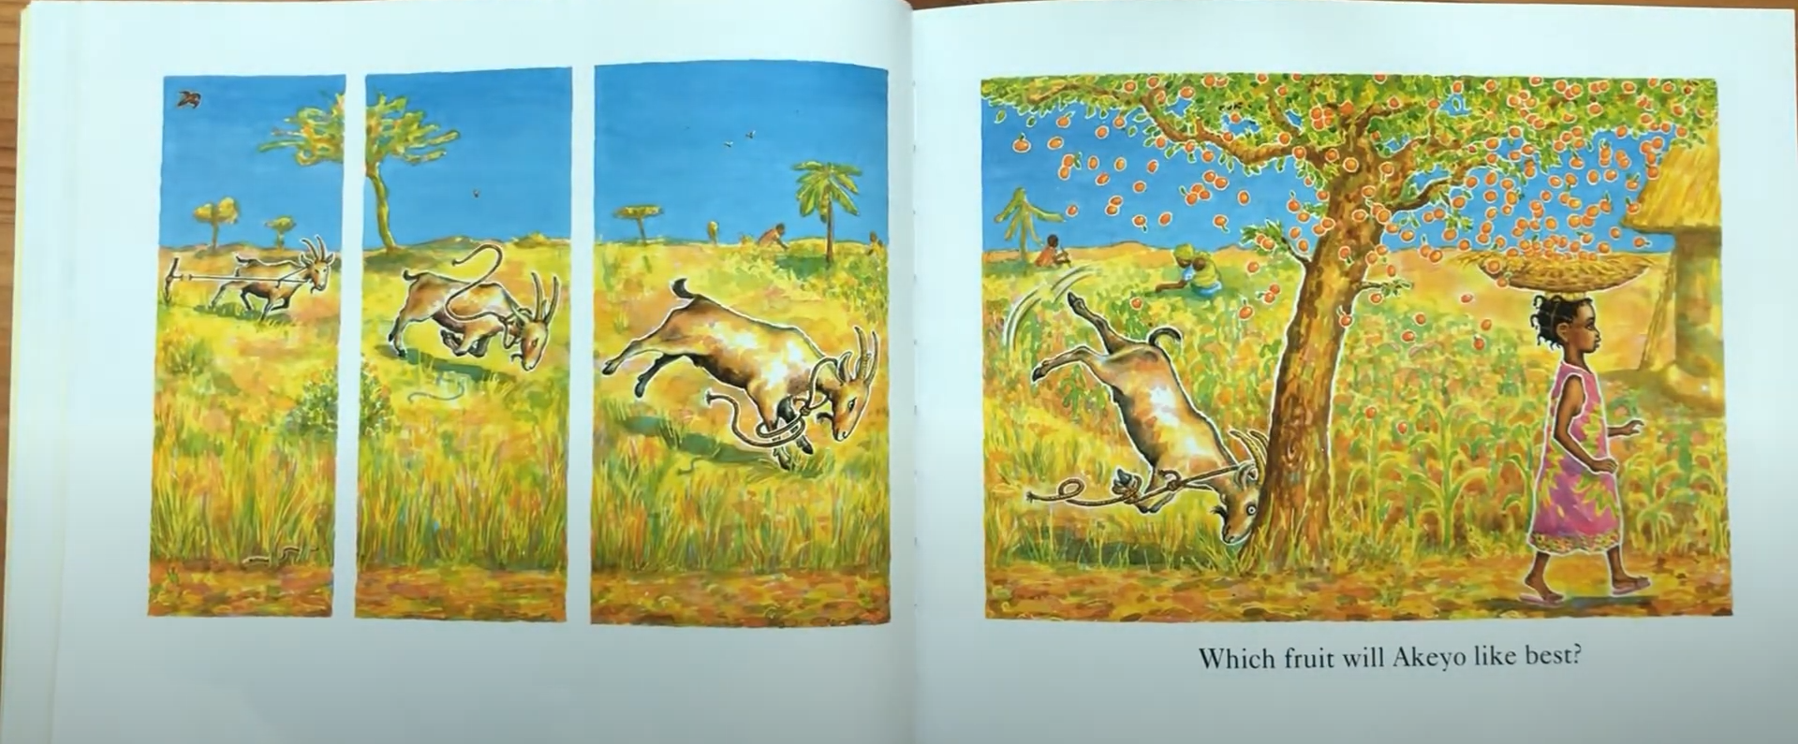
Which fruit will Akeyo like best?

Slide 14
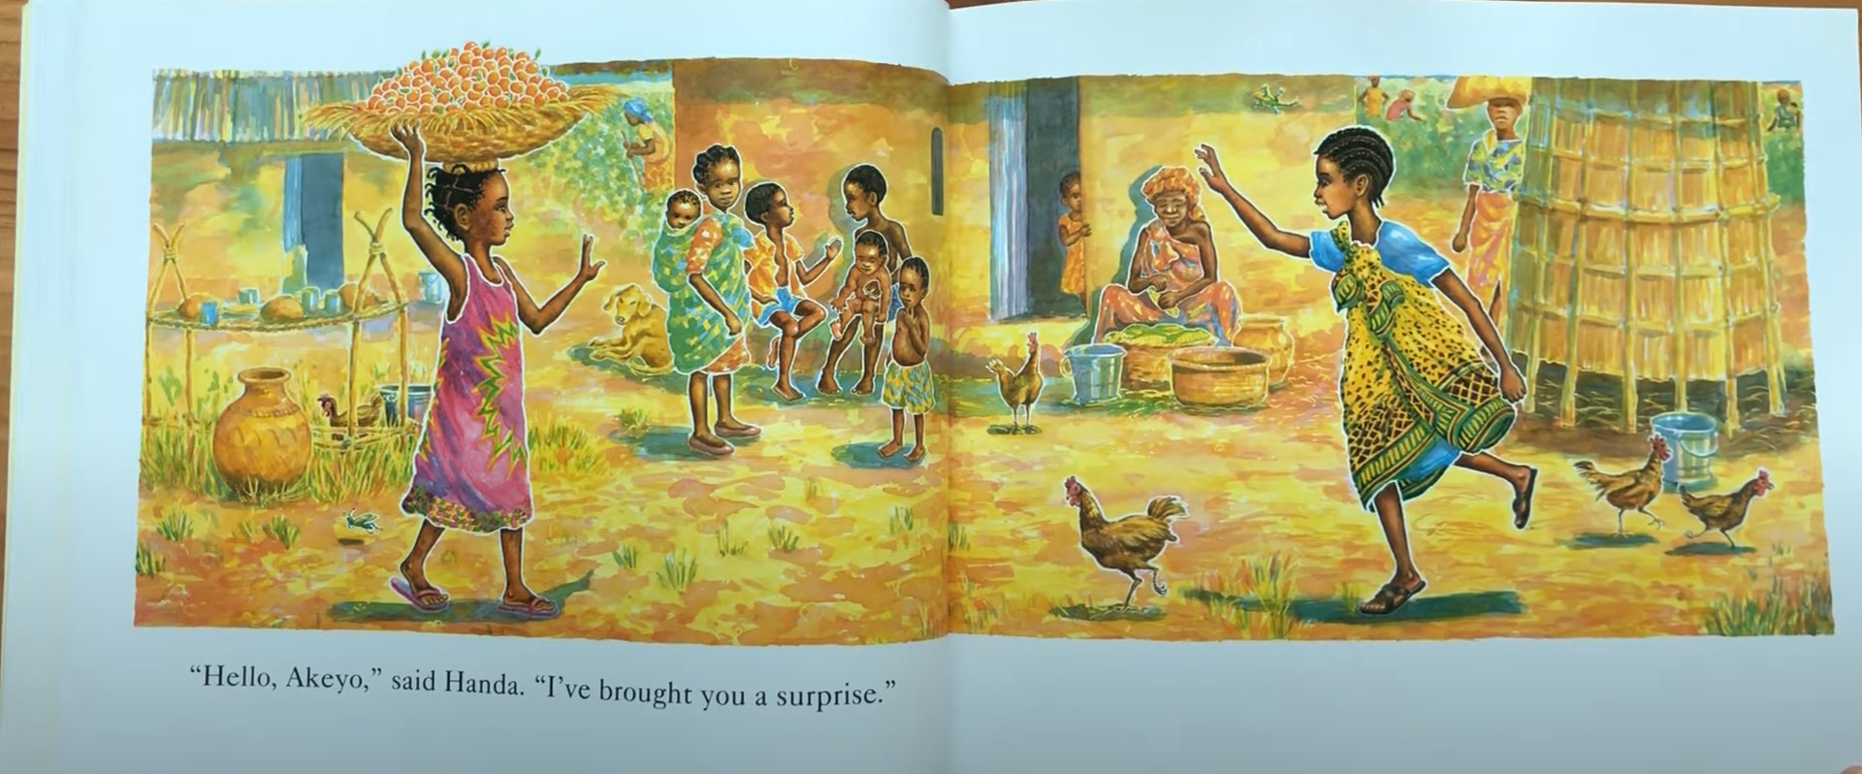
“Hello, Akeyo,” said Handa. “I’ve brought you a surprise.”

Slide 15
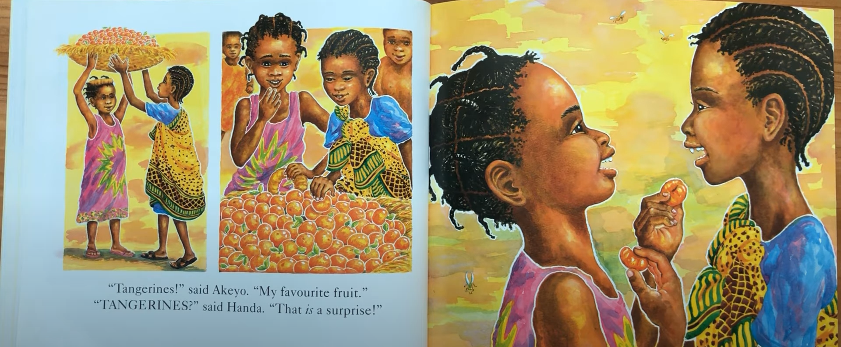
“Tangerines!” said Akeyo. “My favorite fruit.” “TANGERINES?” said Handa. “That is a surprise!”

Slide 16
Animals: monkey → ostrich → zebra → elephant → giraffe → antelope → parrot →goat
Fruits: banana→ guava→ orange→ mango→ pineapple→ avocado→ passion fruit→ tangerine

Slide 17
