Slide 1
Payphone
Maroon 5

Slide 2
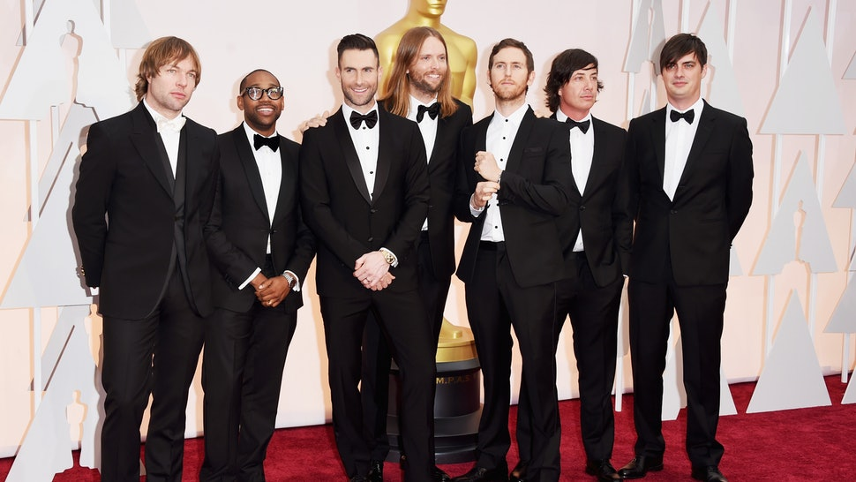
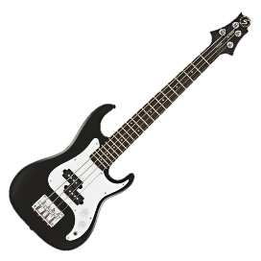
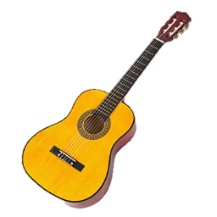
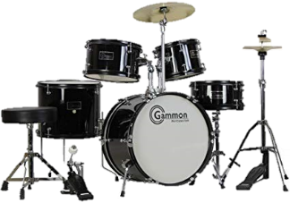
Mickey PJ Adam James Jesse Matt Sam

Slide 3
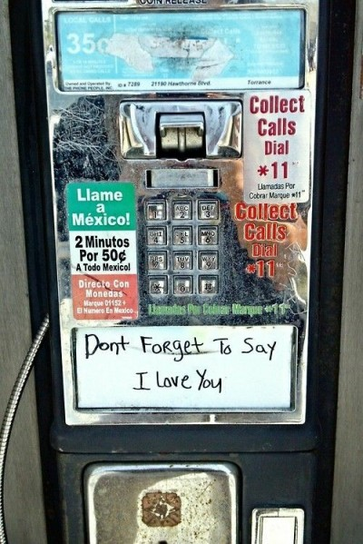
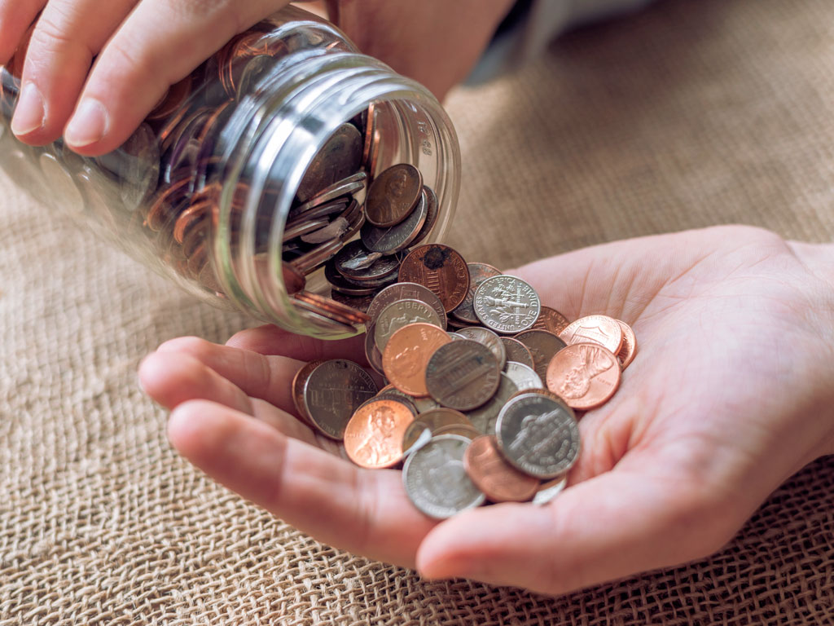
I'm at a payphone trying to call home
All of my change I spent on you
Where have the times gone,
baby it's all wrong
Where are the plans we made for two?

Slide 4
[Verse 1]
Yeah, I, I know it's hard to remember,
The people we used to be...
It's even harder to picture,
That you're not here next to _____________.
me

Slide 5
make
You say it's ________ late to ________ it,
But is it too ________ to ________?
And in our ________ that you wasted
too
late
try
time

Slide 6
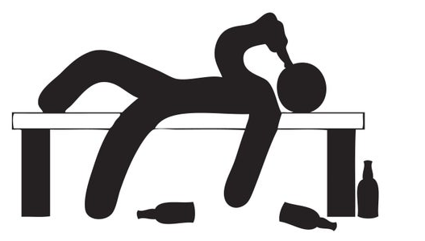
[Pre-chorus]
All of our bridges burned _____________
I've wasted my _____________,
You turned out the _____________
Now I'm paralyzed,
down
nights
lights

Slide 7
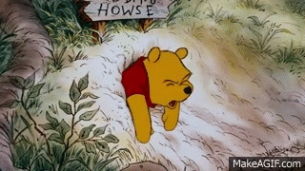
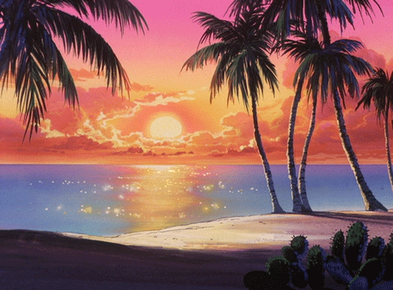
Still stuck in _____________ time,
When we called it _____________,
But even the _____________ sets in paradise
that
love
sun

Slide 8
[Chorus]
I'm at a _______________ trying to call __________
All of my ____________ I spent on _____________
Where have the times gone,
_____________ it's all wrong
Where are the _____________ we made for two?
payphone
home
change
you
baby
plans

Slide 9
_____________ happy ever after did exist,
I would still be holding you _____________ this
All those fairy tales are full of it
One more stupid _____________ song, I'll be sick.
If
like
love

Slide 10
[Verse 2]
Oh, you turned your back on tomorrow
'Cause you forgot yesterday.
I gave you my love to borrow,
But you just _____________ it away.
gave

Slide 11
You can't expect me to be _____________,
I don't expect you to _____________
I know I've said it before,
fine
care

Slide 12
[Pre-chorus]
All of our bridges burned _____________
I've wasted my _____________,
You turned out the _____________
Now I'm paralyzed,
down
nights
lights

Slide 13
Still stuck in _____________ time,
When we called it _____________,
But even the _____________ sets in paradise
that
love
sun

Slide 14
[Chorus]
I'm at a _______________ trying to call __________
All of my ____________ I spent on _____________
Where have the times gone,
_____________ it's all wrong
Where are the _____________ we made for two?
payphone
home
change
you
baby
plans

Slide 15
_____________ happy ever after did exist,
I would still be holding you _____________ this
All those fairy tales are full of it
One more stupid _____________ song, I'll be sick.
If
like
love

Slide 16
Oh, yeah yeah
Now baby don’t hang _____________
So I can tell you what you _____________ to know
Baby I’m begging you just please don’t go
So I can tell you what you need to know
up
need

